Slide 1
Efficient Indexing Strategies

Slide 2














Thank you to our sponsors!
Notes:
Platinum: Capgemini, Evry
Gold: Microsoft, Webstep, Glasspaper, NextBridge, Violin Memory
Silver: Computas
Bronze: Varigence, SQLSentry, Cozyroc
Swag: ApexSQL, SQL Cruise, Pluralsight

Slide 3

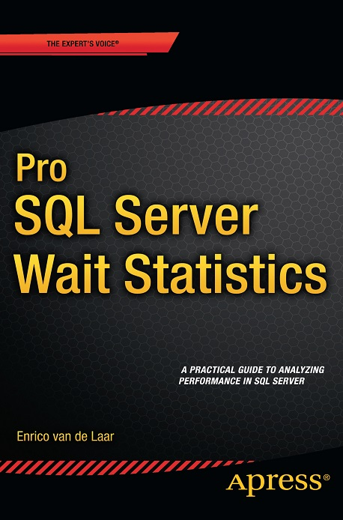


About me
Enrico van de Laar
Microsoft SQL Server MVP
Database Technology Specialist
CEO DotNine SQL Server Training
Blogger
Author
@evdlaar
http://www.dotnine.nl

Slide 4
Agenda
What are indexes and why use them?
The double-edged sword called indexing
Index types & internals
Designing efficient and effective indexes
Index analysis
Index maintenance

Slide 5
What are indexes and why use them?

Slide 6
What are indexes and why use them?
Before we get started…
“
Indexes and indices are both accepted and widely used plurals of the noun index. Both appear throughout the English-speaking world, but indices prevails in varieties of English from outside North America, while indexes is more common in American and Canadian English. Meanwhile, indices is generally preferred in mathematical, financial, and technical contexts, while indexes is relatively common in general usage.
”
Notes:
To avoid grammar arguments….

Slide 7
What are indexes and why use them?
Indexes are used to speed up read access to row data
Notes:
How much faster? Check Demo 1

Slide 8
The double-edged sword called indexing

Slide 9

The double-edged sword called indexing
Did you notice the bold read access in the previous slide?
For reading row data indexes are awesome!
For modifying row data indexes are evil!
This introduces an interesting dilemma…
To index
Or not to index

Slide 10
The double-edged sword called indexing
The answer?
“It depends….”
©
Notes:
Index performance depends on many things: - query workload - query behavior (many read operations or many modifications) - index usage by the query optimizer
- Selectivity and cardinality of the data - etc, etc

Slide 11
The double-edged sword called indexing
The Good | The Bad | The Ugly
Faster read queries | Slower modification queries | Indexes need maintenance
Less storage IO | Index order can lead to bad execution plans | Indexes take up additional space
Potentially less locking and blocking |  | Indexes are not necessarily used
Designing an indexing strategy is an art!

Slide 12
Index types and internals

Slide 13
Index types and internals
Hash
Memory-optimized nonclustered
Clustered
Nonclustered
Columnstore
Filtered
Spatial
XML
Full-Text
Heap (table without clustered index)
Notes:
Index types in SQL Server 2016 CTP2, we are only going to focus on 3 types in this session

Slide 14
Index types and internals
Heaps
A Heap is a table without a clustered index
Inside a heap row data is not stored in any order
When querying against a Heap, the whole table must be read by SQL Server (Table Scan)
Notes:
Important! You can query a Heap table and assume the order is the order of row inserts, this does NOT have to be true! There is no order inside a Heap

Slide 15
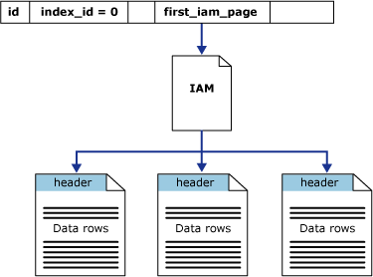
Index types and internals
Heaps
Row x
Notes:
IAM = Index Allocation Map SQL Server will need to go through all the data pages to find the row you are looking for. This is extremely costly!

Slide 16
Index types and internals
Nonclustered Index
Nonclustered Indexes can be created on a Heap
Nonclustered Indexes have their own index structure next to the data pages
If a Heap is just a pile of data pages, a Nonclustered Index acts like a book index, pointing to the data page
Notes:
Maximum amount of Nonclustered indexes on a table is 999

Slide 17
Index types and internals
Nonclustered Index
root
0 - 100
intermediate
0 - 33
34 - 67
68 - 100
leaf
0 - 16
17 - 33
34 - 50
51 - 67
68 - 84
85 - 100
data pages
74
Notes:
Say hello to the B-tree (Balanced) structure indexes use. The B-tree is used to navigate to the requested data page as fast as possible

Slide 18
Index types and internals
Clustered Index
Creating a Clustered Index removes the Heap structure
Clustered Indexes stores the row data, ordered, inside the index structure based on the index key
A Clustered Index can be compared to a phonebook
Notes:
You can only have one Clustered Index per table

Slide 19
Index types and internals
Clustered Index
root
0 - 100
intermediate
0 - 33
34 - 67
68 - 100
74
leaf
0 - 16
17 - 33
34 - 50
51 - 67
68 - 84
85 - 100
Notes:
Clustered indexes eliminates the extra step of navigating to the data pages themselves since row data is stored inside the B-tree. Main advantages of a Clustered Index is that data is stored ordered based on index key, this makes locating data much faster when querying for a range of ID’s for instance. (sequential, instead of random reads)
See Demo 2 for performance difference between Nonclustered and Clustered index

Slide 20
Index types and internals
Clustered Index
Because Clustered Indexes also hold the row data inside the index structure, modifying and inserting row data is potentially more expensive
Anna
Lily
Emma
Kim
Mary
Notes:
The order of the Clustered Index must be maintained, thus adding rows in the middle of the index means moving pages around to make sure the order is correct

Slide 21
Designing efficient and effective indexes

Slide 22
Designing efficient and effective indexes
Since indexes play a large part in the performance of your database you will have to spend time designing them!
Thankfully there are some guidelines and best practices that can help you design your indexing strategy
Notes:
Should the developer or DBA be responsible for indexing?

Slide 23
Designing efficient and effective indexes
Global Guidelines
Ideally Indexes should be narrow, unique and ever-increasing
Indexes should be created on columns that are queried often, by different queries
Multiple indexes should not be created on the same columns, instead combine/include
Don’t “over-index”
Think about the order of the index
Notes:
Narrow -> Small in term of index key storage. The larger the index key the more levels inside the B-tree and the more storage is needed Unique -> If the index key is not unique, SQL Server will add a uniqueifier (4 bytes) on duplicate entries Ever-increasing -> Ever-increasing index keys means new rows will always be inserted at the end of the index

Slide 24
Designing efficient and effective indexes
Global Guidelines
Some recommendations are to create a Clustered Index on every table, but it depends on your workload
Create indexes on “selective” columns
Enough talk, let’s look at some of these guidelines!
Notes:
Selectivity means uniqueness. Low selectivity means high percent of matches, high selectivity low percent of matches Demos for index key size and included columns

Slide 25
Index analysis

Slide 26
Index analysis
Analyzing your index strategy should be a recurring task
Database usage pattern changes impact your indexes as well
Regularly ask yourself: - Do I need to add or drop indexes? - Are my indexes being used? - Can I combine indexes?

Slide 27
Index analysis
Adding indexes
There are some options available to learn if adding indexes might be useful - Missing Indexes Hints (query) - Database Engine Tuning Advisor (workload)
Notes:
Demos Index hints + DTA

Slide 28
Index analysis
Index usage
You will want to check regularly if your indexes are actually being used
Notes:
Demo Index usage script

Slide 29
Index analysis
Duplicate or overlapping indexes
Having duplicate or overlapping indexes will impact performance and storage usage
Notes:
Demo Duplicate/Overlapping indexes script

Slide 30
Index maintenance

Slide 31
Index maintenance
Indexes require maintenance to keep performance as best as possible
The main maintenance action we need to perform is defragging the indexes
Over time, depending on the data modification rate of the index, indexes will get fragmented

Slide 32
Index maintenance
Two types of index fragmentation - Internal - External
Internal fragmentation indicate that index pages are not 100% fully used
External fragmentation means that the index pages are not in order
Notes:
External fragmentation means that more pages need to be read

Slide 33
Index maintenance
Thankfully we can “easily” fix index fragmentation
For instance, Ola Hallengren’s free scripts; https://ola.hallengren.com/sql-server-index-and-statistics-maintenance.html
The main choice you have to make is to either Rebuild or Reorganize the index
Performance increase can be huge!
Notes:
External fragmentation means that more pages need to be read Guidelines are >30% fragmentation = Rebuild, lower = Reorganize Rebuild creates an entire new index structure (offline operation in Standard) Reorginze fixed ordering in leaf level of the index

Slide 34

Your feedback is important!
Please let us know what you thought of this session ☺
http://sqlsaturday.com/414/sessions/sessionevaluation.aspx

Slide 35
Thank you to our sponsors!
Notes:
Platinum: Capgemini, Evry
Gold: Microsoft, Webstep, Glasspaper, NextBridge, Violin Memory
Silver: Computas
Bronze: Varigence, SQLSentry, Cozyroc
Swag: ApexSQL, SQL Cruise, Pluralsight

